Slide 1
Sales and marketing
Maths in the workplace

Slide 2
How our teaching resources are designed for the classroom

Slide 3
I can understand how maths is used in sales and marketing.

Slide 4
Profit is a business’ financial gain; the difference between the revenue and the cost.
A simple formula for total annual profit is:
total revenue − total costs = yearly profit

Slide 5

Sales and marketing
Maths in marketing
Maths in sales

Slide 6
Maths in marketing
If you study business, you will find many different definitions of marketing. One simple way to understand it is to think of your customers as your market, and the process of ‘marketing’ as the way in which you get them interested in buying your product or service.
One way to get people interested in a product or service is through advertising. In the UK, firms spend approximately forty billion pounds per year on advertising.
That is £40 000 000 000

Slide 7
Maths in marketing
Advertising has changed a lot throughout the years.
120 years ago:
Printed adverts in newspapers, magazines and on billboards in towns and cities.
100 years ago:
Radio advertising began.
80 years ago:
TV advertising began.
These forms dominated until …
20 years ago:
Digital, online advertising began.
Companies in the UK now spend more on online advertising than any other form.

Slide 8
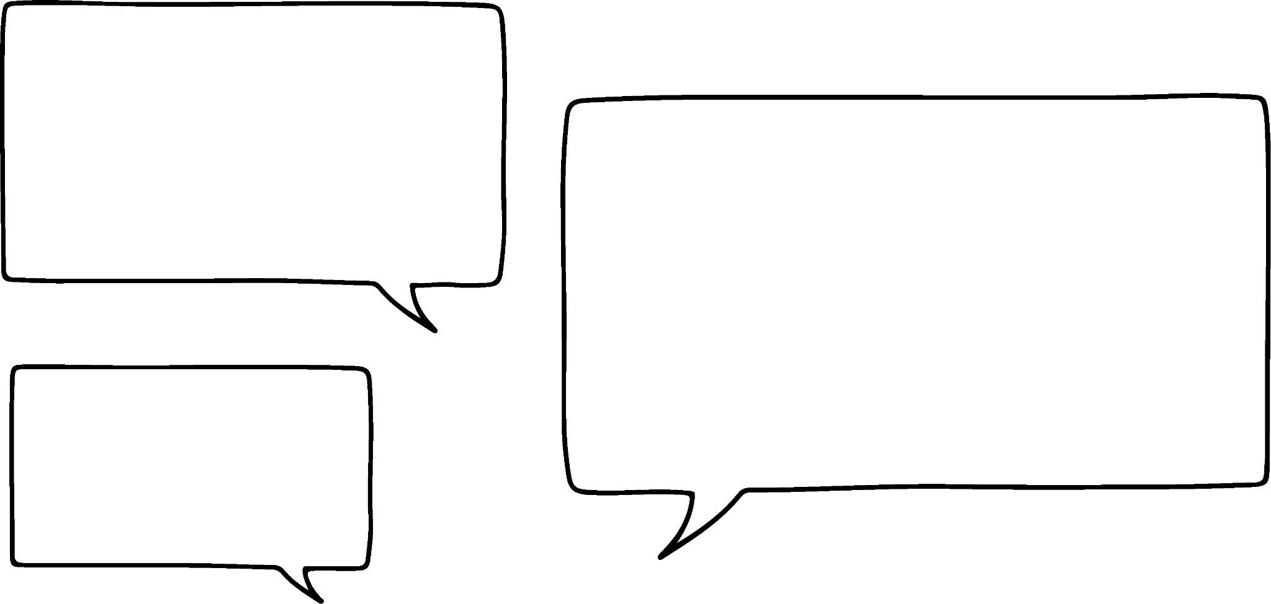

Maths in marketing
Sam runs a clothing company called ‘Sam’s Sleepwear’ specialising in really comfortable bedtime clothing.
They sell exclusively online, so driving traffic (people) to their website is fundamental to their business’ success.
I use Google Analytics to understand which advertising is the most effective. It gives me so much good data!

Slide 9
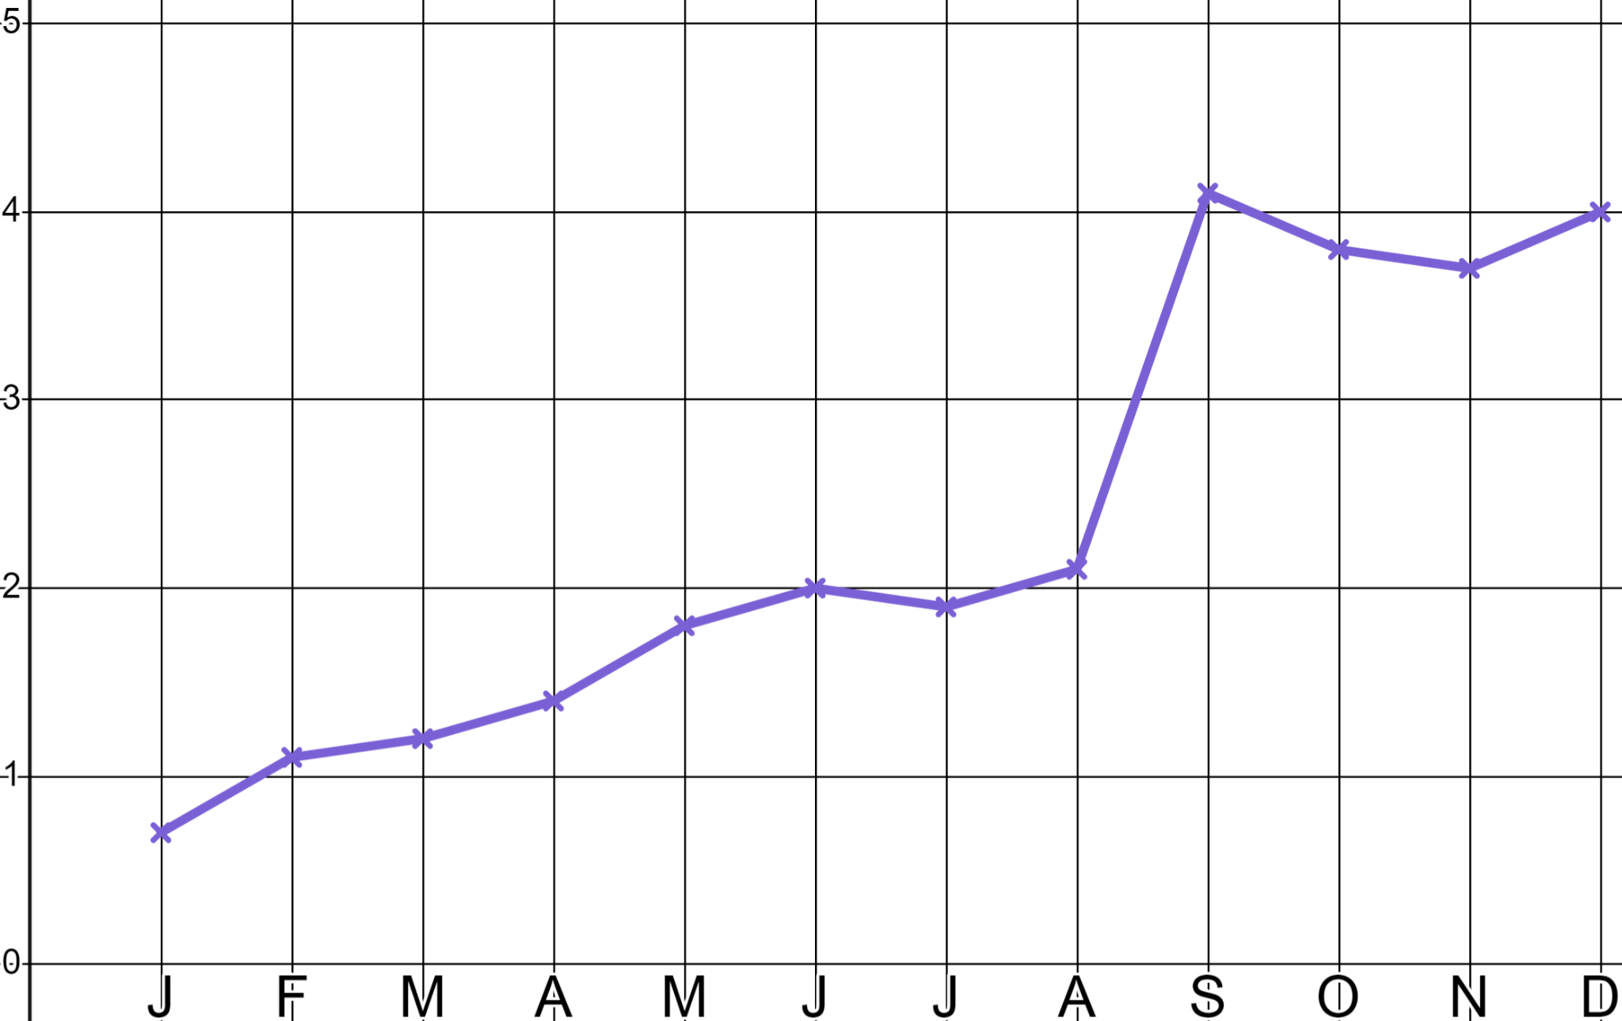
Maths in marketing
This is Sam’s website traffic data for their first trading year.
Site visits (000’s)
Can you guess when I invested some money in online advertising?
Sam invested in online advertising in September which generated 2000 more site visits.
Month

Slide 10
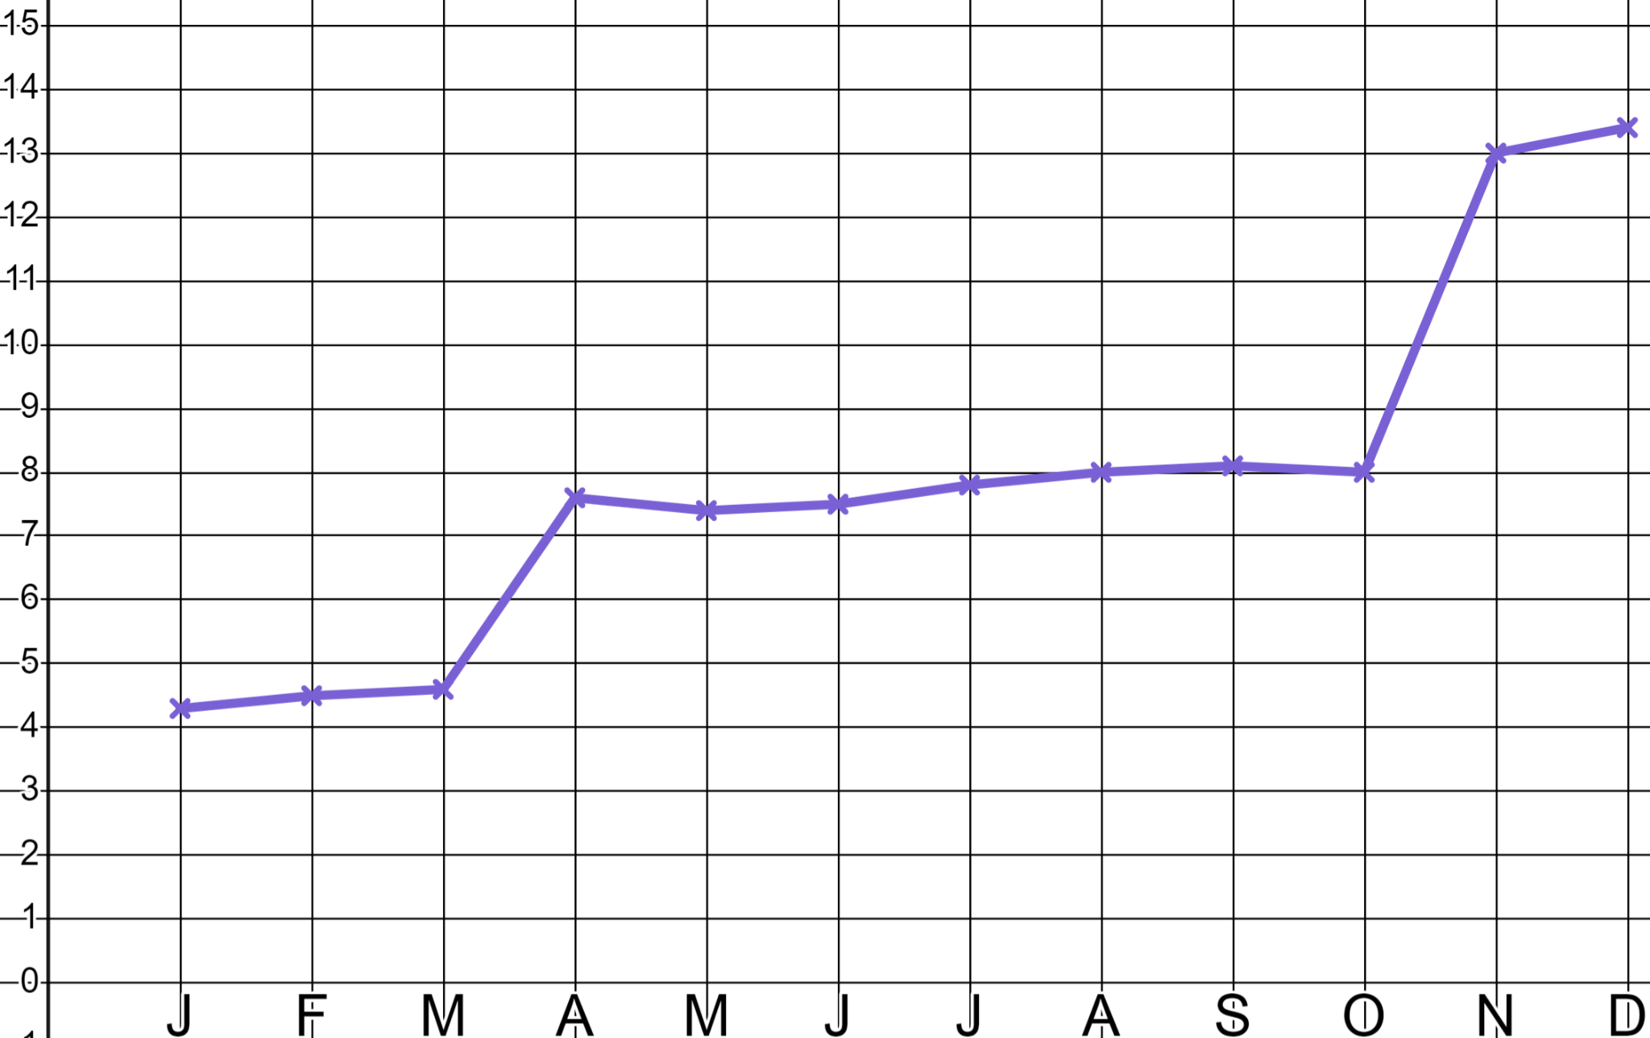
Maths in marketing
This is Sam’s website traffic data for their second trading year.
Investment in April generating approximately 3000 more site visits.
Site visits (000’s)
When did Sam spend money on advertising?
Approximately how many extra site visits did this generate?
Investment in November generating approximately 5000 more site visits.
Month

Slide 11
Maths in marketing
Google analytics tells me where these extra 5000 November visitors to my site came from.
Site visits (000’s)
Investment in November generating approximately 5000 more site visits.
Month

Slide 12
Maths in marketing
Google analytics tells me where these extra 5000 November visitors to my site came from.
Direct email
(20%)
YouTube advert
(50%)
YouTube:
Facebook advert
(30%)
0.5 × 5000 = 2500 visits
Facebook:
0.3 × 5000 = 1500 visits
Direct email:
0.2 × 5000 = 1000 visits

Slide 13
Maths in marketing
These are my extra 3000 April visitors. Can you work out how many came from each media?
Insta advert
(11%)
YouTube advert
(61%)
Facebook advert
(28%)
YouTube:
0.61 × 3000 = 1830 visits
Facebook:
0.28 × 3000 = 840 visits
Insta:
0.11 × 3000 = 330 visits

Slide 14
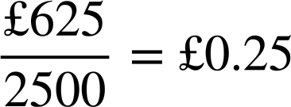
Maths in marketing
These are my extra 5000 November visitors again. I know YouTube works but it’s expensive!
Direct email
(20%)
YouTube advert
(50%)
YouTube: 2500 visits
Facebook advert
(30%)
Facebook: 1500 visits
Direct email: 1000 visits
YouTube: £625
Facebook: £270
Direct email: £140

Slide 15
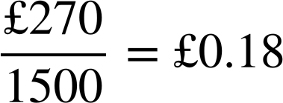
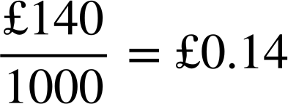
Maths in marketing
It costs £0.25 to generate each visitor when I advertise on YouTube. Can you work out if Facebook or email are better value?
Direct email
(20%)
YouTube advert
(50%)
YouTube: 2500 visits
Facebook advert
(30%)
Facebook: 1500 visits
Direct email: 1000 visits
YouTube: £625
Facebook: £270
Direct email: £140
Facebook and direct email are cheaper than YouTube advertising.

Slide 16
Maths in marketing
Google analytics also tells me where people go upon visiting my website. It tells me that 1 in 50 visitors go on to make a purchase. I make an average of £12 profit with every sale.
I still maintain a profit when I advertise through a direct email campaign.
YouTube: £625
Facebook: £270
Direct email: £140
£0.25 per visit
£0.18 per visit
£0.14 per visit
£0.14 × 50 = £7
12 − 7 = £5 profit

Slide 17
Maths in marketing
Google analytics also tells me where people go upon visiting my website. It tells me that 1 in 50 visitors go on to make a purchase. I make an average of £12 profit with every sale.
Does Sam still maintain a profit when advertising through Facebook and YouTube?
YouTube: £625
Facebook: £270
Direct email: £140
£0.25 per visit
£0.18 per visit
£0.14 per visit
£0.25 × 50 = £12.50
£0.18 × 50 = £9
£0.14 × 50 = £7
12 − 12.50 = £0.50 loss
12 − 9 = £3 profit
12 − 7 = £5 profit

Slide 18
Maths in marketing
Google analytics also tells me where people go upon visiting my website. It tells me that 1 in 50 visitors go on to make a purchase. I make an average of £12 profit with every sale.
Expensive advertising formats diminish profit but, they can help improve brand recognition and repeat sales. Businesses need to balance the risk and reward of such investments.
YouTube: £625
Facebook: £270
Direct email: £140
£0.25 per visit
£0.18 per visit
£0.14 per visit
£0.25 × 50 = £12.50
£0.18 × 50 = £9
£0.14 × 50 = £7
12 − 12.50 = £0.50 loss
12 − 9 = £3 profit
12 − 7 = £5 profit

Slide 19
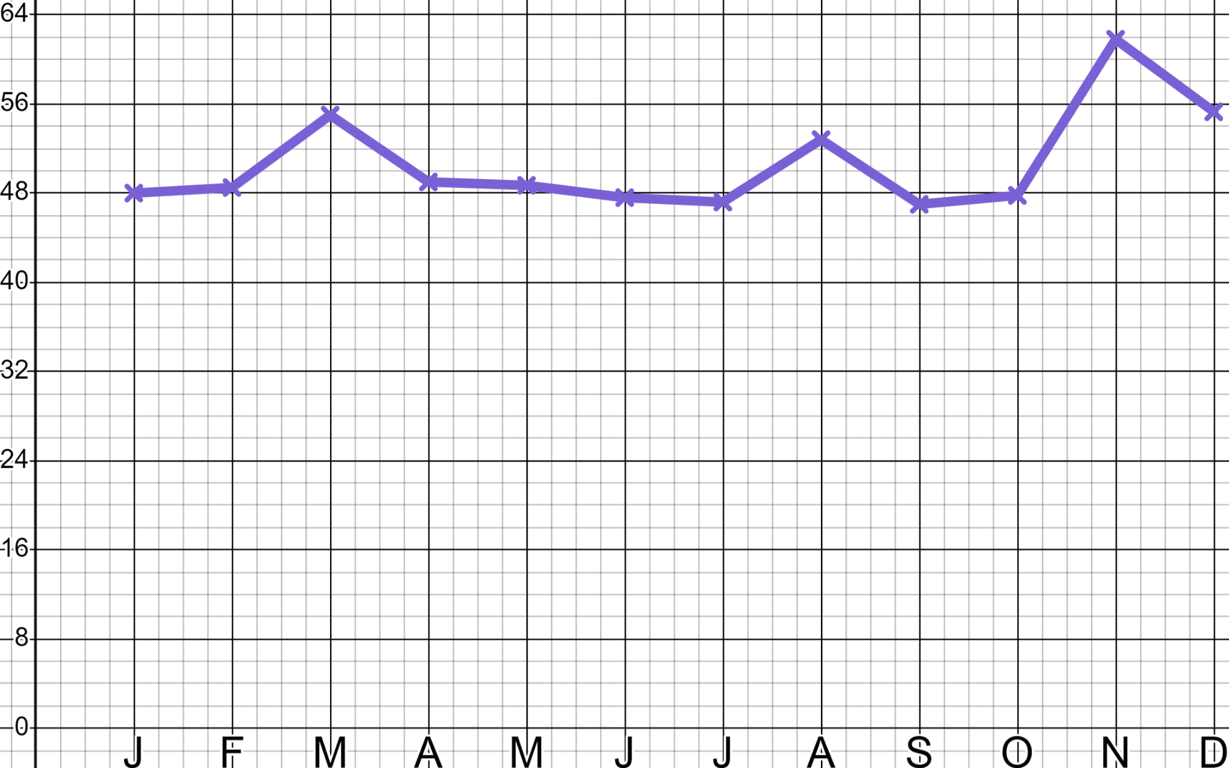
Maths in marketing
1) ‘Sam’s Sleepwear’ is now well established in the bedwear marketplace. On three occasions in this year they spent just under £5000 on online advertising campaigns.
When were those campaigns?
Which one was the most effective?
How do you know?
Site visits (000’s)
Month

Slide 20
Maths in marketing
2) ‘Sam’s Sleepwear’ is now well established in the bedwear marketplace. They spend the below on advertising and generate 14 000 extra visitors to their website.
YouTube advert
(28%)
Googleadvert
(38%)
YouTube £1100
Direct email £350
Facebook £500
Google £2500
They now make a sale from 1 in 40
visitors and an average of £14 per sale.
Facebook advert
(16%)
Direct email
(18%)
Calculate which form of media is the most profitable and advise Sam as to where to spend their next advertising budget.

Slide 21
Maths in marketing
1) ‘Sam’s Sleepwear’ is now well established in the bedwear marketplace. On three occasions in this year they spent just under £5000 on online advertising campaigns.
When were those campaigns?
Which one was the most effective?
How do you know?
Site visits (000’s)
Month

Slide 22
Maths in marketing
1)
You might have said:
“The advertising campaigns happened in March, August and November.”
“We know that the November campaign was the most effective one because it resulted in the greatest ‘spike’(increase) in site visits.”
Site visits (000’s)
Month

Slide 23
Maths in marketing
2) ‘Sam’s Sleepwear’ is now well established in the bedwear marketplace. They spend the below on advertising and generate 14 000 extra visitors to their website.
YouTube advert
(28%)
Google advert
(38%)
YouTube £1100
Direct email £350
Facebook £500
Google £2500
They now make a sale from 1 in 40
visitors and an average of £14 per sale.
Facebook advert
(16%)
Direct email
(18%)
Calculate which form of media is the most profitable and advise Sam as to where to spend their next advertising budget.

Slide 24
Maths in marketing
2)
YouTube £1100
Facebook £500
0.28 × 14 000 = 3920 visitors
0.16 × 14 000 = 2240 visitors
£1100 ÷ 3920 = £0.28… per visit
£500 ÷ 2240 = £0.22… per visit
£0.28… × 40 = £11.22… per sale
£0.22… × 40 = £8.92… per sale
£14 − £11.22… ≈ £2.78 profit
£14 − £8.92… ≈ £5.07 profit
Direct email £350
Google £2500
0.18 × 14 000 = 2520 visitors
0.38 × 14 000 = 5320 visitors
£350 ÷ 2520 = £0.13… per visit
£2500 ÷ 5320 = £0.46… per visit
£0.13… × 40 = £5.55… per sale
£0.46… × 40 = £18.79… per sale
£14 − £5.55… ≈ £8.44 profit
£14 − £18.79… ≈ £4.80 loss

Slide 25
Maths in marketing
2)
You might have advised:
“Google is expensive and currently unprofitable for a business of your size.”
Google £2500
0.38 × 14 000 = 5320 visitors
£2500 ÷ 5320 = £0.46… per visit
£0.46… × 40 = £18.79… per sale
£14 − £18.79… ≈ £4.80 loss

Slide 26
Maths in marketing
2)
You might have advised:
“Direct email campaigns remain the most profitable form of advertising for your business, your market.”
“You spent more than seven times £350 advertising on Google. Perhaps redirect that money and do more direct email campaigns.”
Direct email £350
0.18 × 14 000 = 2520 visitors
£350 ÷ 2520 = £0.13… per visit
£0.13… × 40 = £5.55… per sale
£14 − £5.55… ≈ £8.44 profit

Slide 27
Maths in marketing
2)
You might have advised:
YouTube £1100
Facebook £500
0.28 × 14 000 = 3920 visitors
0.16 × 14 000 = 2240 visitors
£1100 ÷ 3920 = £0.28… per visit
£500 ÷ 2240 = £0.22… per visit
£0.28… × 40 = £11.22… per sale
£0.22… × 40 = £8.92… per sale
£14 − £11.22… ≈ £2.78 profit
£14 − £8.92… ≈ £5.07 profit
“YouTube and Facebook are both more expensive and less profitable than direct email but, they still make a profit and give your brand/business good exposure so continue to invest in these.”

Slide 28
Sales and marketing
Maths in marketing
Maths in sales

Slide 29


Maths in sales
Jacob and Izzy run a business selling high quality frying pans in the catering industry. Last year the business sold 200 000 units at a price of £30 each.
Jacob is the sales director and makes a proposal at a board meeting.
Market research shows that if we half our price we can double our sales. That would make us the market leader. I think we should do it.
Do you think it’s a good idea?

Slide 30
Maths in sales
200 000 × £30 = 400 000 × £15
The proposal is a curious one.
The business currently sells 200 000 units at a price of £30 generating £6 000 000 in revenue.
Halving the price to £15 and selling 400 000 units will generate the exact same revenue of £6 000 000
We’ll be the market leaders! We’ll make the biggest sales in this company’s history!

Slide 31
Maths in sales
Thankfully Izzy is a commercial accountant who understands the difference between revenue and profit.
Revenue is the income into our business, i.e. the total money that goes in the till from our sales. Whereas, profit is our financial gain; the difference between our revenue and the cost to make our goods.

Slide 32
Maths in sales
Thankfully Izzy is a commercial accountant who understands the difference between revenue and profit.
We currently sell 200 000 units at a price of £30 each. Each of those units costs us £20 to manufacture, package and distribute.
Can you see the problem now with Jacob’s proposal to ‘Half the price, double the sales’?

Slide 33
Maths in sales
This is a classic example of where mathematics helps businesses with crucial decision making which could make or break their business.
Current situation:
200 000 units sold p.a.
Selling price per unit: £30
The business ‘made’ £2 000 000 in profit.
Cost price per unit: £20
Profit per unit: £30 − £20 = £10
Annual profit: 200 000 × £10 = £2 000 000

Slide 34
Maths in sales
An alternative way to look at the same numbers…
Current situation:
This might be an easier way to understand profit versus revenue. “We spent £4 000 000 to make £6 000 000. That’s a profit of £2 000 000”
200 000 units sold p.a.
Selling price per unit: £30
Cost price per unit: £20
Revenue: 200 000 × £30 = £6 000 000
Costs: 200 000 × £20 = £4 000 000
Profit = Revenue − Costs = £6 000 000 − £4 000 000 = £2 000 000

Slide 35
Maths in sales
This is how an accountant would interpret Jacob’s proposal.
New situation:
400 000 units sold p.a.
Selling price per unit: £15
The business ‘made a loss’ of £2 000 000
Cost price per unit: £20
Profit per unit: £15 − £20 = −£5
Annual profit: 400 000 × −£5 = −£2 000 000

Slide 36
Maths in sales
Alternatively…
“We spent £8 000 000 to make £6 000 000. We lost £2 000 000”
New situation:
400 000 units sold p.a.
This is clearly not a sensible thing to do. Businesses use mathematics in the form of commercial accounting to make decisions on pricing.
Selling price per unit: £15
Cost price per unit: £20
Revenue: 400 000 × £15 = £6 000 000
Costs: 400 000 × £20 = £8 000 000
Profit = Revenue − Costs = £6 000 000 − £8 000 000 = −£2 000 000

Slide 37


Maths in sales
Aisha and Alex work for a business that sells archery sets.
Their business currently sells 12 000 units p.a. at a price of £80 and the cost of producing, packaging and distributing each unit is £50 Calculate their annual revenue and profit.
Revenue: 12 000 × £80 = £960 000
Costs: 12 000 × £50 = £600 000
Profit = Revenue − Costs
= £960 000 − £600 000 = £360 000

Slide 38
Maths in sales
Aisha and Alex work for a business that sells archery sets.
Current situation:
12 000 units sold p.a.
Selling price: £80
Cost price: £50
Customers have told me if we half our price they will buy twice as many sets. We’d really hit the bullseye with our sales numbers!
Be the accountant and show why it would be a poor commercial decision to halve their prices.

Slide 39
Maths in sales
Aisha and Alex work for a business that sells archery sets.
Current situation:
New situation:
12 000 units sold p.a.
24 000 units sold p.a.
Selling price: £80
Selling price: £40
Cost price: £50
Cost price: £50
Profit = £360 000
Revenue: 24 000 × £40 = £960 000
Costs: 24 000 × £50 = £1 200 000
Profit
= £960 000 − £1 200 000 = −£240 000
The change would see them make a loss of £240 000

Slide 40
Maths in sales
The accountants have to consider every decision and sometimes the results are unexpected.
Current situation:
Market research shows that if increase our price by 10% our sales will go down by 15%. I think we should do it.
200 000 units sold p.a.
Selling price per unit: £30
Cost price per unit: £20
Do you think this is a good idea?

Slide 41
Maths in sales
This is an interesting conundrum because your intuition may tell you that a loss of 15% for a gain of 10% is not worth it.
Current situation:
Market research shows that if increase our price by 10% our sales will go down by 15%. I think we should do it.
200 000 units sold p.a.
Selling price per unit: £30
Cost price per unit: £20
But remember, accountants are there to help us understand our profitability.

Slide 42
Maths in sales
Let’s be the accountant and calculate what a 10% rise in price for a 15% loss in sales does to our business.
Current situation:
New situation:
200 000 units sold p.a.
170 000 units sold p.a.
Selling price per unit: £30
Selling price per unit: £33
Cost price per unit: £20
Cost price per unit: £20
Revenue: £6 000 000
Revenue: 170 000 × £33 = £5 610 000
Costs: £4 000 000
Costs: 170 000 × £20 = £3 400 000
Profit = £2 000 000
Profit = £2 210 000
This decision actually increases their profit!

Slide 43

Maths in sales
The year is 2050 and Laura’s Lunar Launches charge £250 000 for a day-trip to the Moon with an included surface walk.
They currently take 600 passengers p.a. at a cost to the business of £225 000 per person.
Market research tells us if we drop our price by 5% we will get 30% more passengers. My sales team want to do it to grow market share. Should we do it?

Slide 44
Maths in sales
Current situation:
600 flights
Selling price: £250 000
Cost price: £225 000
Revenue: 600 × £250 000 = £150 000 000
Costs: 600 × £225 000 = £135 000 000
Profit = £150 000 000 − £135 000 000 = £15 000 000

Slide 45
Maths in sales
Current situation:
New situation:
600 flights
780 flights (30% more)
Selling price: £250 000
Selling price: £237 500 (5% drop)
Cost price: £225 000
Cost price: £225 000
Revenue: £150 000 000
Revenue: 780 × £237 500 = £185 250 000
Costs: £135 000 000
Costs: 780 × £225 000 = £175 500 000
Profit: £15 000 000
Profit: £9 750 000
You might have said, “Don’t make the change Laura. Whilst it will generate more revenue it will cost the business more than £5 000 000 in profit.”

Slide 46

Maths in sales
1) Jun is CEO of a sweet manufacturer that sold 36 000 packets of sweets last year at £1.80 a packet. Their manufacturing cost is £0.60 per unit.
a) Calculate Jun’s current revenue and profit.
b) If Jun could double his sales by halving his price should he?
c) If Jun could increase his sales by a third by reducing his price by one third should he?

Slide 47

Maths in sales
2) Andeep is a commercial accountant for a guitar manufacturer that sells 1200 units a year at £600 per unit and costs £480 per unit to make.
Which of the below are good commercial deals?
a) 5% uplift in sales for a 10% drop in price?
b) 50% uplift in sales for a 15% drop in price?
c) 10% drop in sales for a 5% increase in price?
d) If Andeep were to drop his price by 12% what percent uplift in sales would he need to see to maintain his existing profit?

Slide 48
Maths in sales
1) Jun is CEO of a sweet manufacturer that sold 36 000 packets of sweets last year at £1.80 a packet. Their manufacturing cost is £0.60 per unit.
a) Calculate Jun’s current revenue and profit.
36 000 packets
Selling price: £1.80
Cost price: £0.60
Revenue: 36 000 × £1.80 = £64 800
Costs: 36 000 × £0.60 = £21 600
Profit = £64 800 − £21 600 = £43 200

Slide 49
Maths in sales
1)
b) If Jun could double his sales by halving his price should he?
72 000 packets
You might have said, “Whilst this will increase volume and market share it halves your profit so I recommend you don’t”.
Selling price: £0.90
Cost price: £0.60
Revenue: 72 000 × £0.90 = £64 800
Costs: 72 000 × £0.60 = £43 200
Profit = £64 800 − £43 200 = £21 600

Slide 50
Maths in sales
1)
c) If Jun could increase his sales by a third by reducing his price by one third should he?
You might have said, “Whilst this will increase volume and market share it will reduce profit by one third so I recommend you don’t”.
48 000 packets
Selling price: £1.20
Cost price: £0.60
Revenue: 48 000 × £1.20 = £57 600
Costs: 48 000 × £0.60 = £28 800
Profit = £57 600 − £28 800 = £28 800

Slide 51
Maths in sales
2) Andeep is a commercial accountant for a guitar manufacturer that sells 1200 units a year at £600 per unit and costs £480 per unit to make.
Which of the below are good commercial deals?
a) 5% uplift in sales for a 10% drop in price?
b) 50% uplift in sales for a 15% drop in price?
c) 10% drop in sales for a 5% increase in price?
d) If Andeep were to drop his price by 12% what percent uplift in sales would he need to see to maintain his existing profit?

Slide 52

Maths in sales
2)
Current:
a) 5% uplift in sales for a 10% drop in price?
1200 guitars
1260 guitars
Selling price: £600
Selling price: £540
Cost price: £480
Cost price: £480
Revenue: 1200 × £600 = £720 000
Revenue: 1260 × £540 = £680 400
Costs: 1200 × £480 = £576 000
Costs: 1260 × £480 = £604 800
Profit: £144 000
Profit: £75 600

Slide 53
Maths in sales
2)
Current:
b) 50% uplift in sales for a 15% drop in price?
1200 guitars
1800 guitars
Selling price: £600
Selling price: £510
Cost price: £480
Cost price: £480
Revenue: 1200 × £600 = £720 000
Revenue: 1800 × £510 = £918 000
Costs: 1200 × £480 = £576 000
Costs: 1800 × £480 = £864 000
Profit: £144 000
Profit: £54 000

Slide 54

Maths in sales
2)
Current:
c) 10% drop in sales for a 5% increase in price?
1200 guitars
1080 guitars
Selling price: £600
Selling price: £630
Cost price: £480
Cost price: £480
Revenue: 1200 × £600 = £720 000
Revenue: 1080 × £630 = £680 400
Costs: 1200 × £480 = £576 000
Costs: 1080 × £480 = £518 400
Profit: £144 000
Profit: £162 000

Slide 55
Maths in sales
2)
d) If Andeep were to drop his price by 12% what percent uplift in sales would he need to see to maintain his existing profit?
Current total profit: £144 000
New price: £600 × 0.88 = £528
New profit per unit: £528 − £480 = £48
£144 000 ÷ £48 = 3000 units
They would need to see a 150% increase in sales to achieve the same profit.
3000 ÷ 1200 = 2.5 = 250%

Slide 56
Sales and marketing
In marketing we can use data from systems like Google Analytics to identify which types of advertising are most profitable to our business.
In sales we know that the sales team will always want to reduce the price to increase their volume of sales but the accountants can do the maths to help understand if that decision would be a profitable one.

Slide 57

© Oak National Academy 2024.
Produced in partnership with Mathematics in Education and Industry.
Licensed on the Open Government Licence v3.0, except where otherwise stated. See Oak terms and conditions.

